Slide 1
Medical Ratios
MATH A104
Megan Gobeille
UAA

Slide 2
Medical ratios
Amoxicillin is an antibiotic obtainable in a liquid suspension form, part medication and part water, and is frequently used to treat infections in infants. One formulation of the drug contains 125 mg of amoxicillin per 5 mL of liquid. A pediatrician orders 150 mg per day for a 4-month-old child with an ear infection. How much of the amoxicillin suspension would the parent need to administer to the infant in order to achieve the recommended daily dose?

Slide 3
Medical proportions
A 5% dextrose solution (D5W) contains 5 g of pure dextrose per 100 mL of solution. A doctor orders 500 mL of D5W IV for a patient. How much dextrose does the patient receive from that IV?

Slide 4

Medical Ratios
Give 1500 mL of saline solution IV with a drop factor of 10 $\frac{drops}{mL}$ as a rate of 50 $\frac{drops}{min}$ to an adult patient. Find out how long in hours the IV should be administered.

Slide 5

Percent concentration
$Percent concentration=\frac{mass or volume of component}{total mass or volume}×100$
What is the percent by mass of a solution that contains 26.5 g of glucose with 473.5 g of diluent?

Slide 6
Percent concentration
If you mix 150 g of a 22% sugar solution with 250 g of a 16% sugar solution, what percent of the mix is sugar?
Game plan:

Slide 7
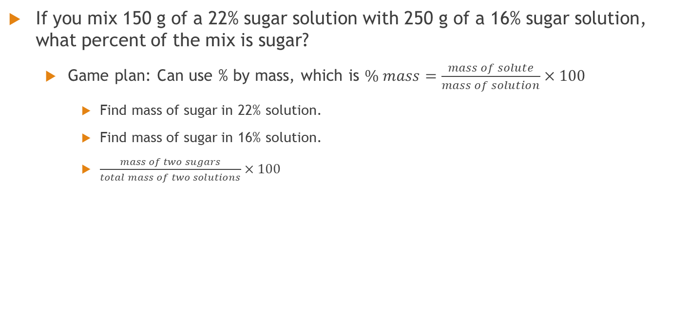
Percent concentration
If you mix 150 g of a 22% sugar solution with 250 g of a 16% sugar solution, what percent of the mix is sugar?
Game plan: Can use % by mass, which is $\% mass=\frac{mass of solute}{mass of solution}×100$
Find mass of sugar in 22% solution.
Find mass of sugar in 16% solution.
$\frac{mass of two sugars}{total mass of two solutions}×100$

Slide 8

Dilution factors
Dilution factors = percent concentration without the percent
Leave as a ratio
Dilution factor of $\frac{1}{10}$ means the solution is… ___ part sample and ___ part diluent?

Slide 9
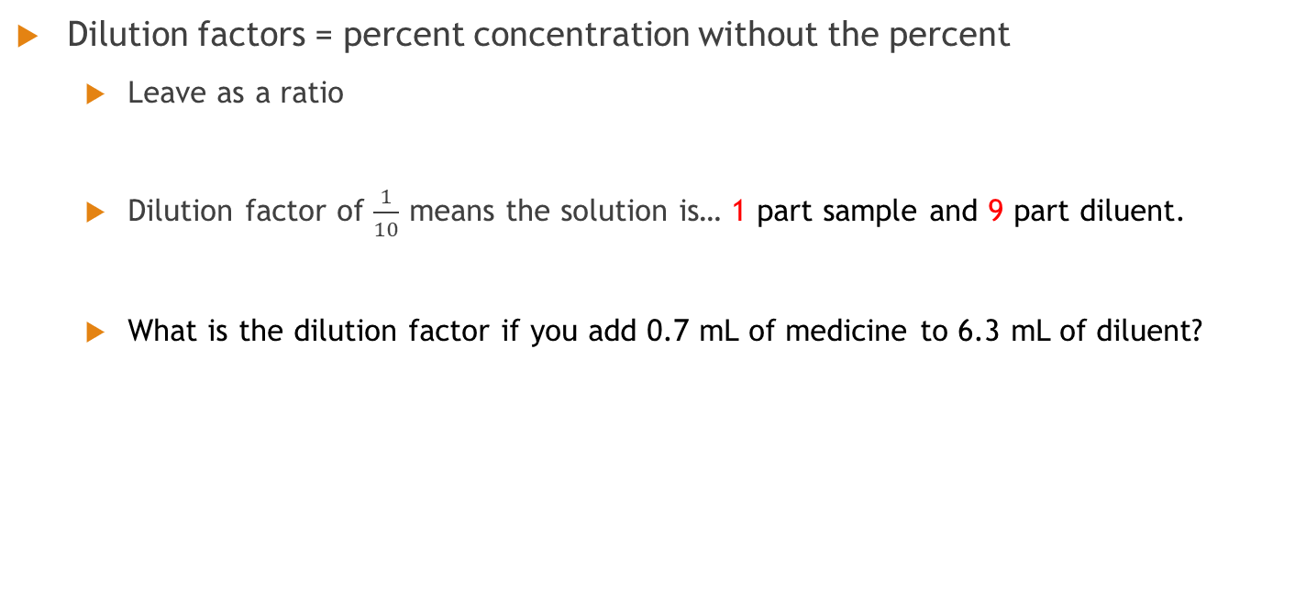
Dilution factors
Dilution factors = percent concentration without the percent
Leave as a ratio
Dilution factor of $\frac{1}{10}$ means the solution is… 1 part sample and 9 part diluent.
What is the dilution factor if you add 0.7 mL of medicine to 6.3 mL of diluent?

Slide 10
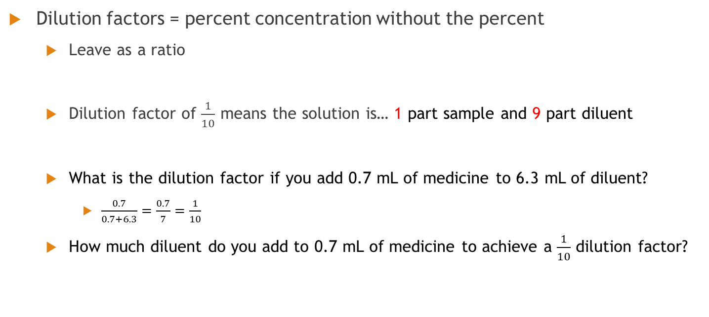
Dilution factors
Dilution factors = percent concentration without the percent
Leave as a ratio
Dilution factor of $\frac{1}{10}$ means the solution is… 1 part sample and 9 part diluent
What is the dilution factor if you add 0.7 mL of medicine to 6.3 mL of diluent?
$\frac{0.7}{0.7+6.3}=\frac{0.7}{7}=\frac{1}{10}$
How much diluent do you add to 0.7 mL of medicine to achieve a $\frac{1}{10}$ dilution factor?

Slide 11
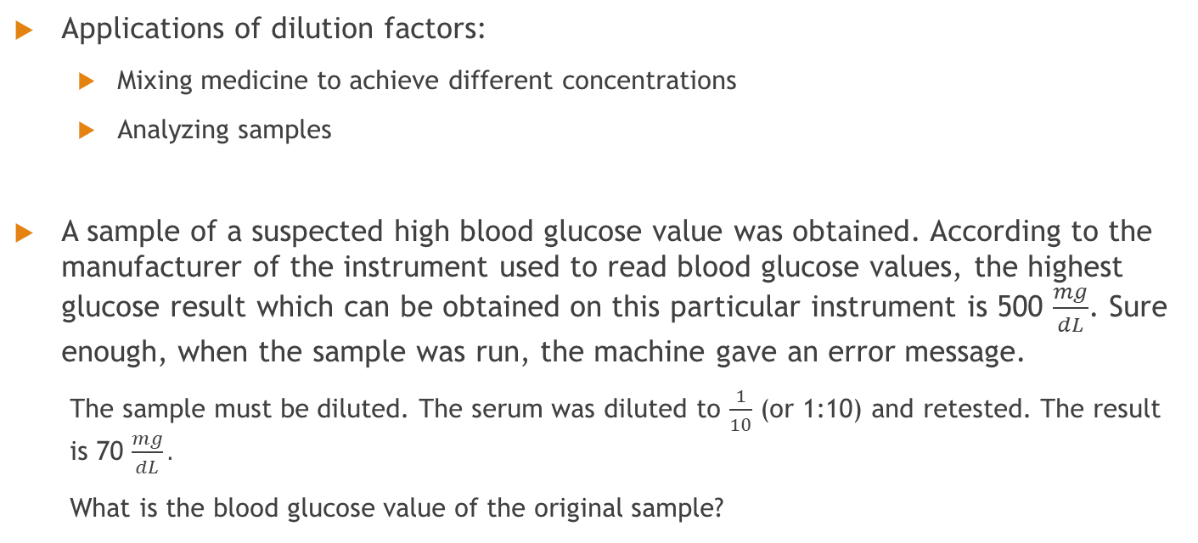
Dilution factors
Applications of dilution factors:
Mixing medicine to achieve different concentrations
Analyzing samples
A sample of a suspected high blood glucose value was obtained. According to the manufacturer of the instrument used to read blood glucose values, the highest glucose result which can be obtained on this particular instrument is 500 $\frac{mg}{dL}$. Sure enough, when the sample was run, the machine gave an error message.
The sample must be diluted. The serum was diluted to $\frac{1}{10}$ (or 1:10) and retested. The result is 70 $\frac{mg}{dL}.$
What is the blood glucose value of the original sample?

Slide 12

Serial Dilution
What do you think would happen if we diluted something to $\frac{1}{10}$, then diluted THAT by a $\frac{1}{2}$ dilution factor?
Would we add?
Would we multiply?
Would we do something else entirely?

Slide 13

Serial Dilution
When diluting a dilution, multiply the dilution factors.
Easier example:
If a $\frac{1}{8}$ dilution of a stock solution is made, then a $\frac{1}{6}$dilution of that is made, what is the final dilution factor?

Slide 14
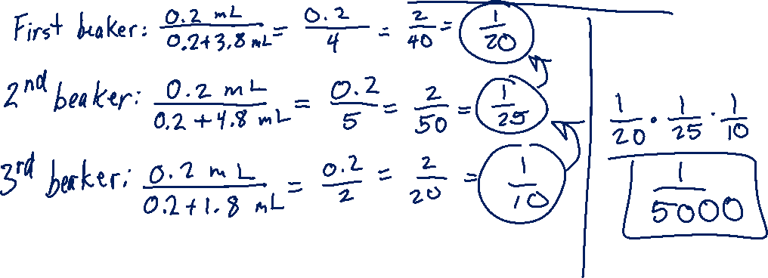
Serial dilution
Harder example:
In one beaker, 0.2 mL of medicine is added to 3.8 mL of diluent. From that beaker, we pull 0.2 mL of solution and put it in a second beaker with 4.8 mL of diluent. After mixing that, we pull 0.2 mL of solution from the second beaker and place it in a third beaker with 1.8 mL of diluent. What is the dilution factor in beaker 3?

Slide 15

Desired volume at desired concentration
We want 20.0 $\frac{mg}{dL}$ of a creatinine solution (don’t ask me why). To prepare 50.0 mL of this working standard, how many mL of the stock standard (with a concentration of 2.5 $\frac{mg}{mL}$) creatinine is needed? Hint: look at your units!

